Slide 1

Employee Payroll Management System
BY- GROUP 7 234 JAVA Batch

Slide 2

Team Members
2582828 Daram Srinivasareddy
2582944 Dharmavarapu Tharun Kumar
2582639 Gara Anil
2584106 Gokula Thanuja
2583191 Gona Pavani
2582114 Harshada Pradip Gawande
2583596 Jangamgari Anvesh Goud
2582853 Kalyan Bhaulal Aher

Slide 3
Contents
Introduction
Objective
Tools & Languages Used
Features of Employee Payroll Management System
Advantages
App Flow
E-R Diagram
Screen Shots Of Output and details
Conclusion

Slide 4
Introduction
Employee payroll management system is an Internet-based Java application that automates the working of a company or work center that manage and maintain records of the employees in the different department.
The proposed project “Employee Payroll Management System” has been developed to overcome the problems faced in the practicing of manual system.
This web application is reduced as much as possible to avoid errors while entering data.

Slide 5
objective
The Primary objective of the design is to deliver the requirement as delivered by the feasibility report. There are some objective we kept in mind.
Practically : The system is quite stable and can be operated by the Employees with average intelligence.
Efficiency : We tried to involve accuracy, timelines and comprehensiveness of system output.

Slide 6
Front End:
Visual Studio
Angular
HTML
CSS
BOOTSTRAP
Back End
Eclipse
MySQL
Spring Data JPA
Postman
Tools & Languages

Slide 7
Features of Employee Payroll Management System
Admin can do :
Adding Employees.
Adding Salary for Employees.
Adding leaves for Employees.
Can Schedule work to Employees.
Can Add Attendance to Employees.

Slide 8
Features of Employee Payroll Management System
Employees can do :
View and Edit their Profile.
View their Approved Leaves.
View their Attendance.
View their Assigned Work Details.
View and Download their Salary Slips.

Slide 9
Advantages
Helps the employee easy way to access their data.
The information related to employee can be added , edited, removed easily.
Store the end-to-end data of the employees
Provides transparency in salary calculations, contributing to employee trust and satisfaction

Slide 10
App Flow :
START
ADMIN
EMPLOYEE
LOGIN
LOGIN
ADD EMP
ADD LEAVE
ADD WORK
VIEW SALARY
VIEW WORK
CHANGE PASSWORD
ADD SALARY
ADD ATTENDANCE
VIEW LEAVE
VIEW ATTENDANCE
LOGOUT

Slide 11
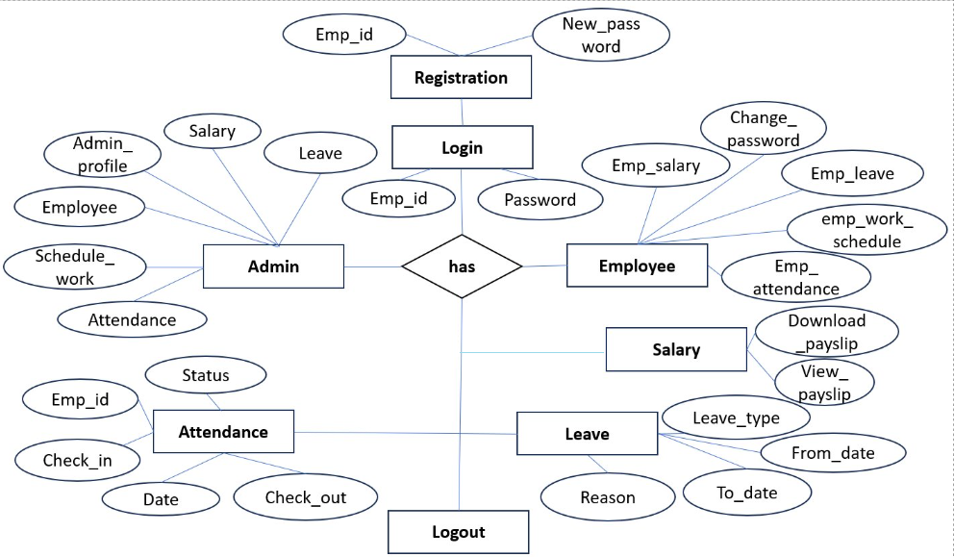
E-R Diagram:

Slide 12
Screenshot of Output and Details

Slide 13
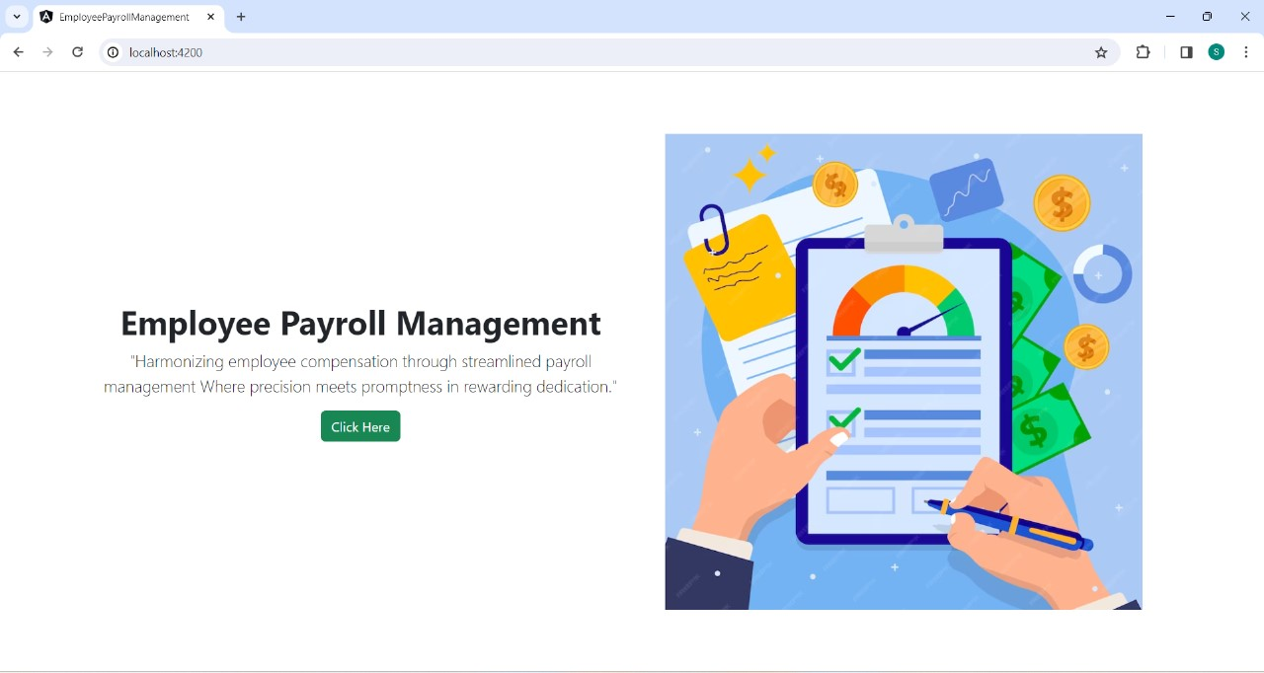
Home Page

Slide 14
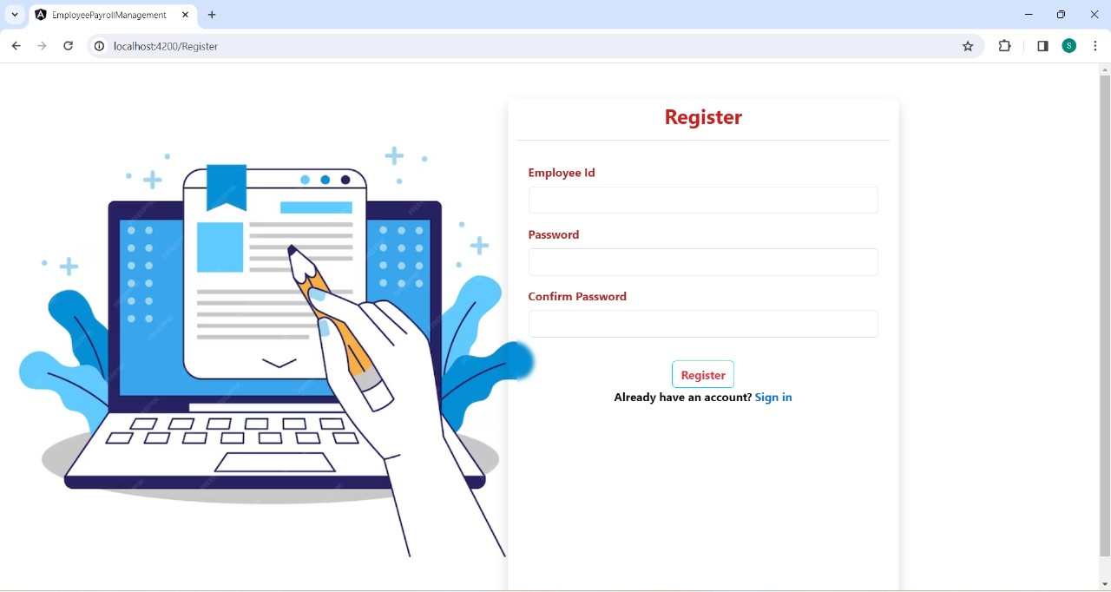
Registration Page

Slide 15
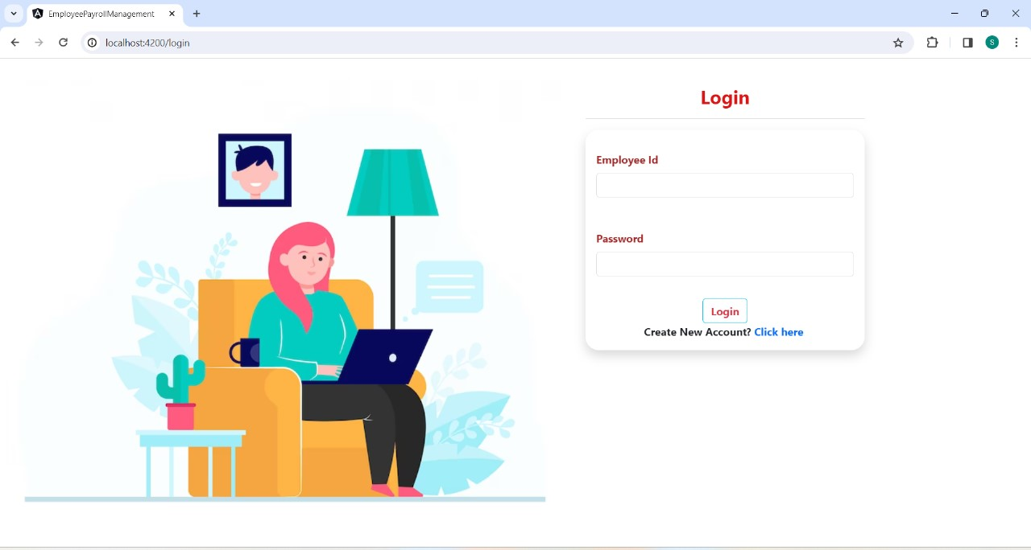
Login Page

Slide 16
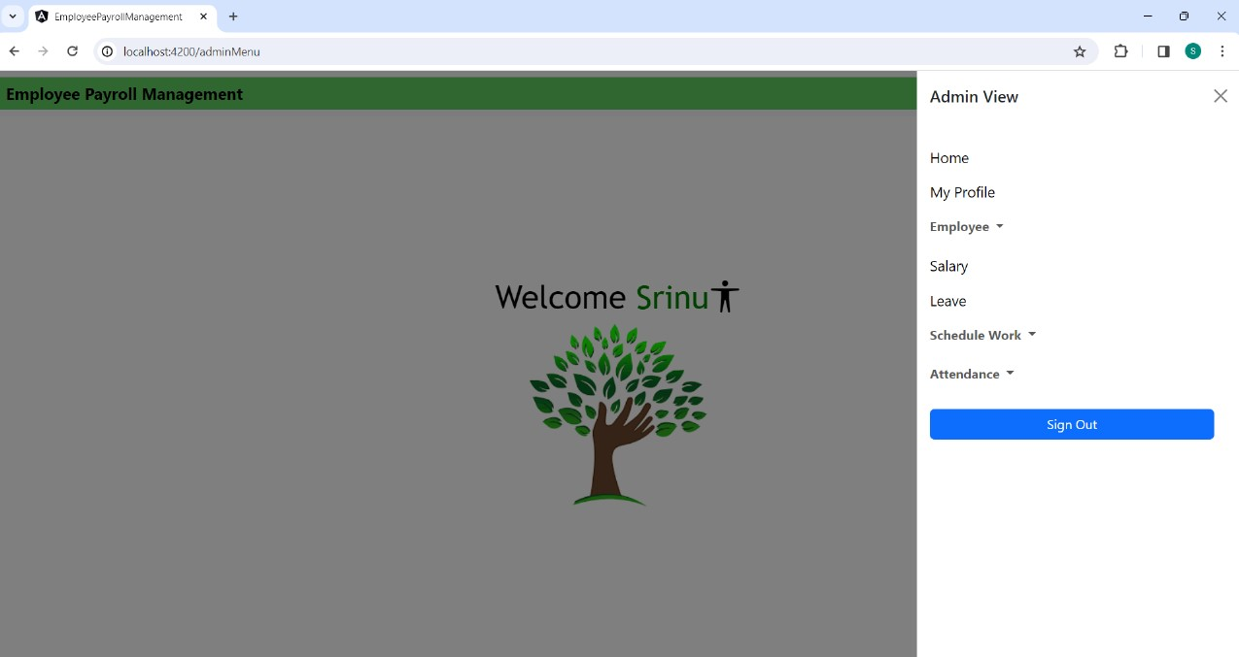
Admin Menu

Slide 17
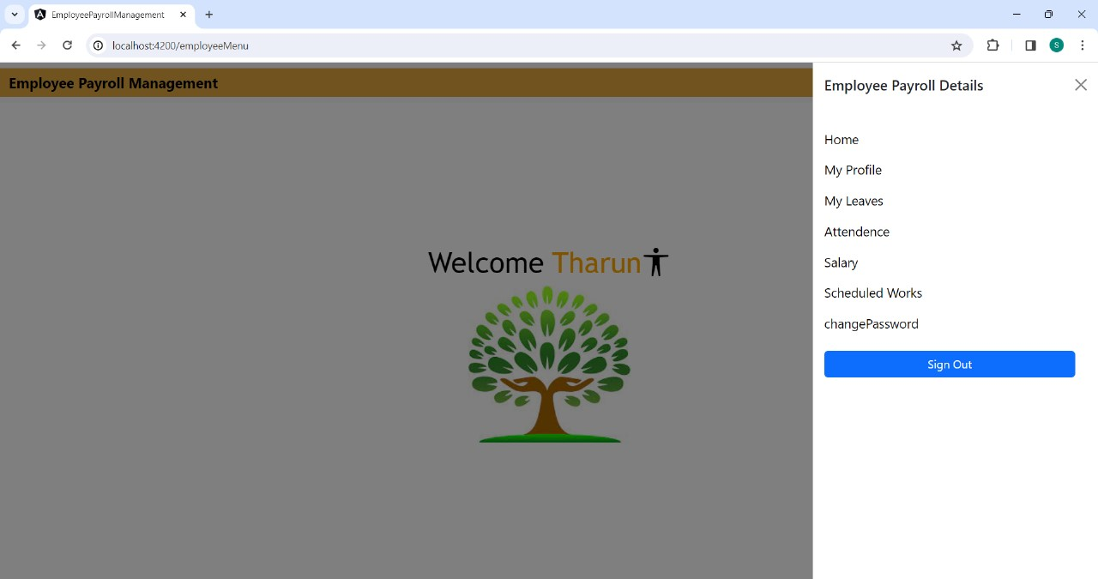
Employee Menu

Slide 18
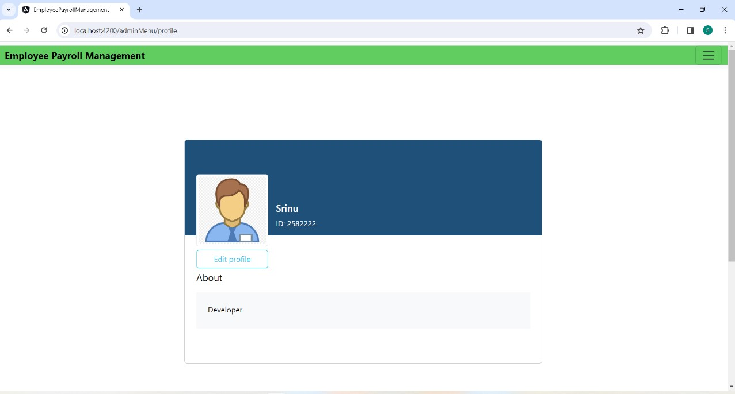
Admin Profile

Slide 19
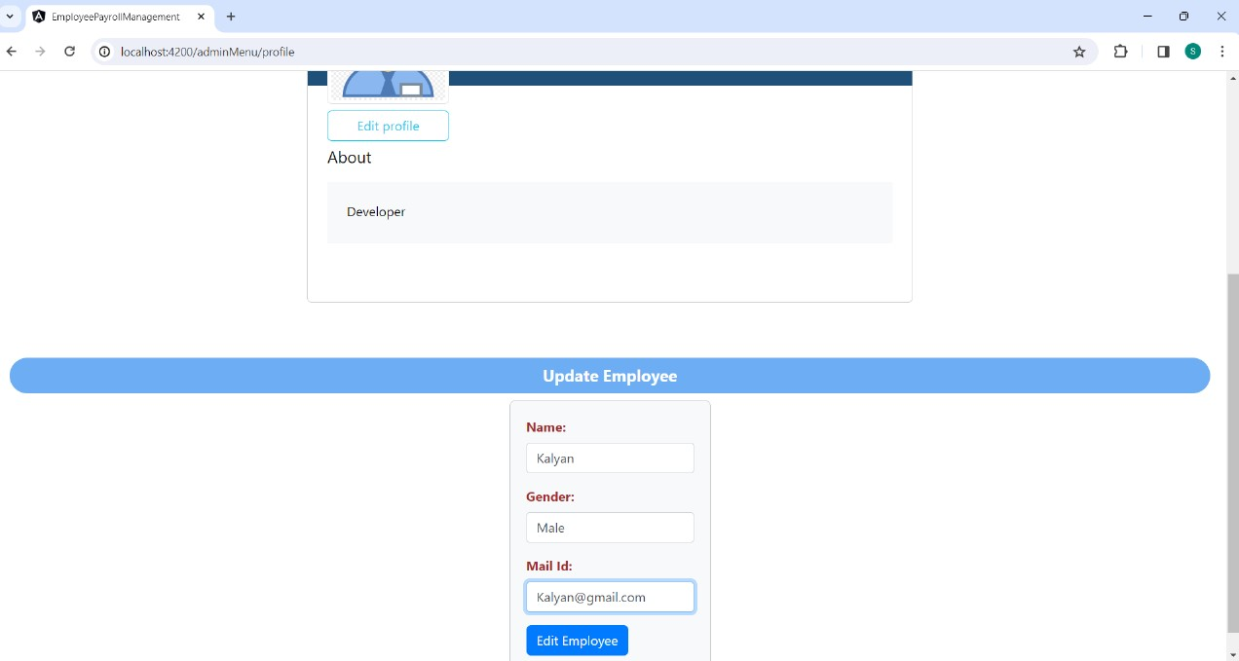
Admin Update Profile

Slide 20
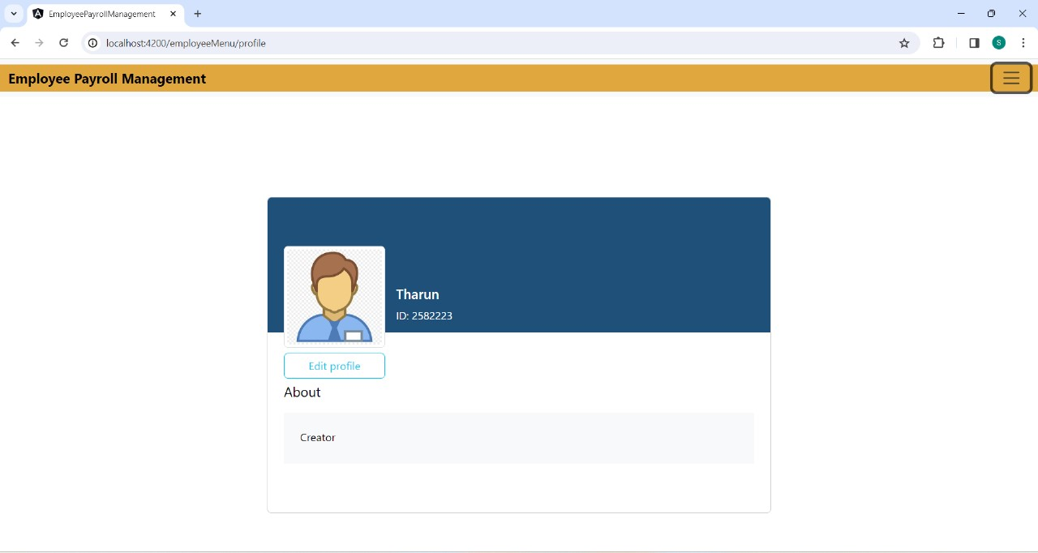
Employee Profile

Slide 21
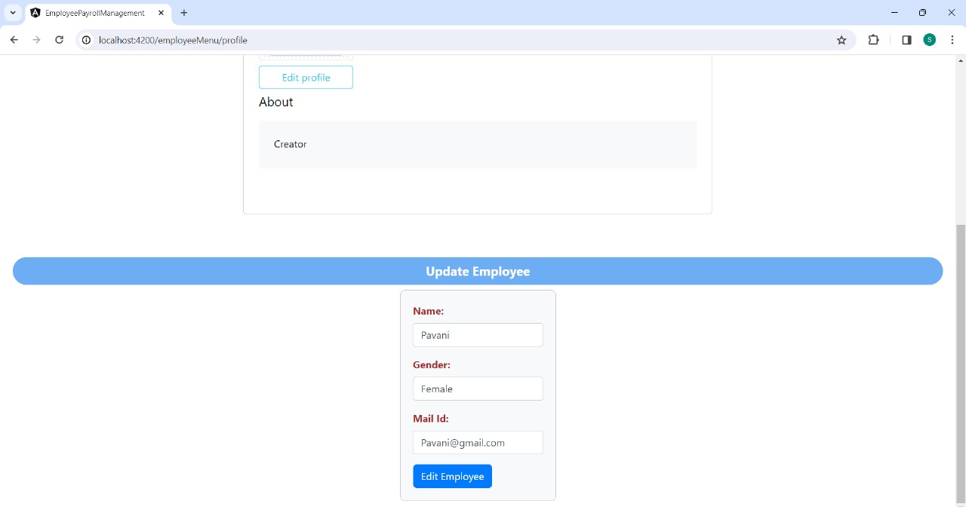
Employee Update Profile

Slide 22
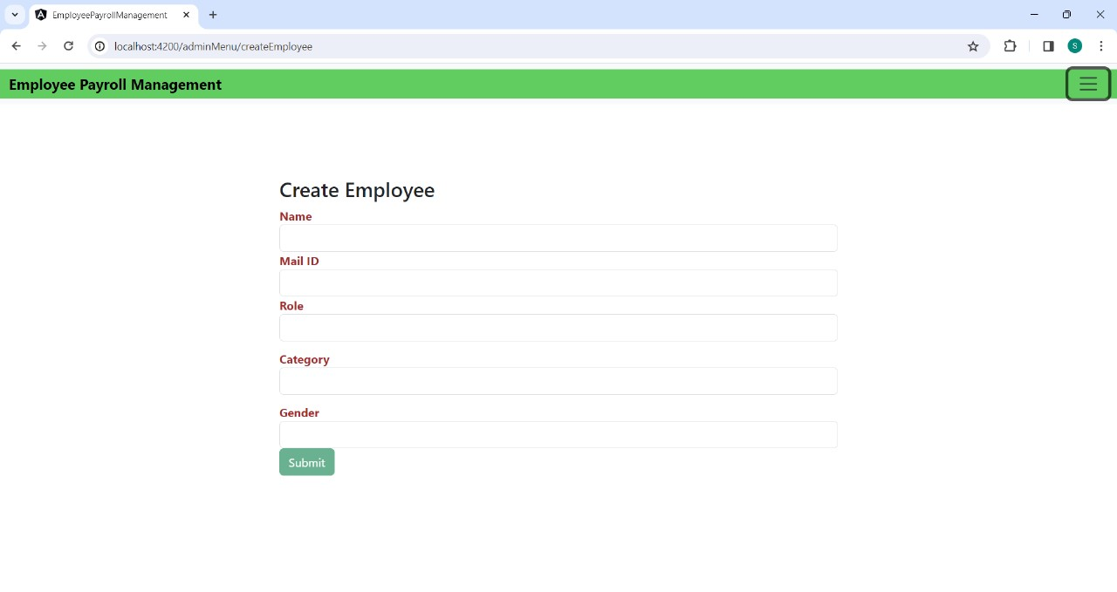
Create Employee

Slide 23
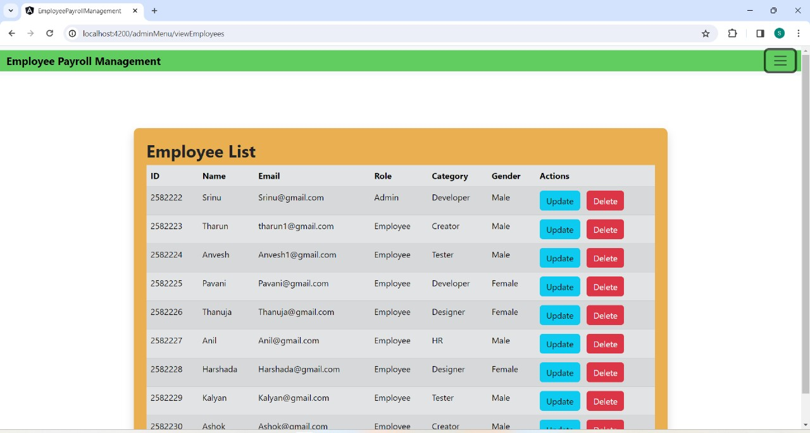
View All Employees

Slide 24
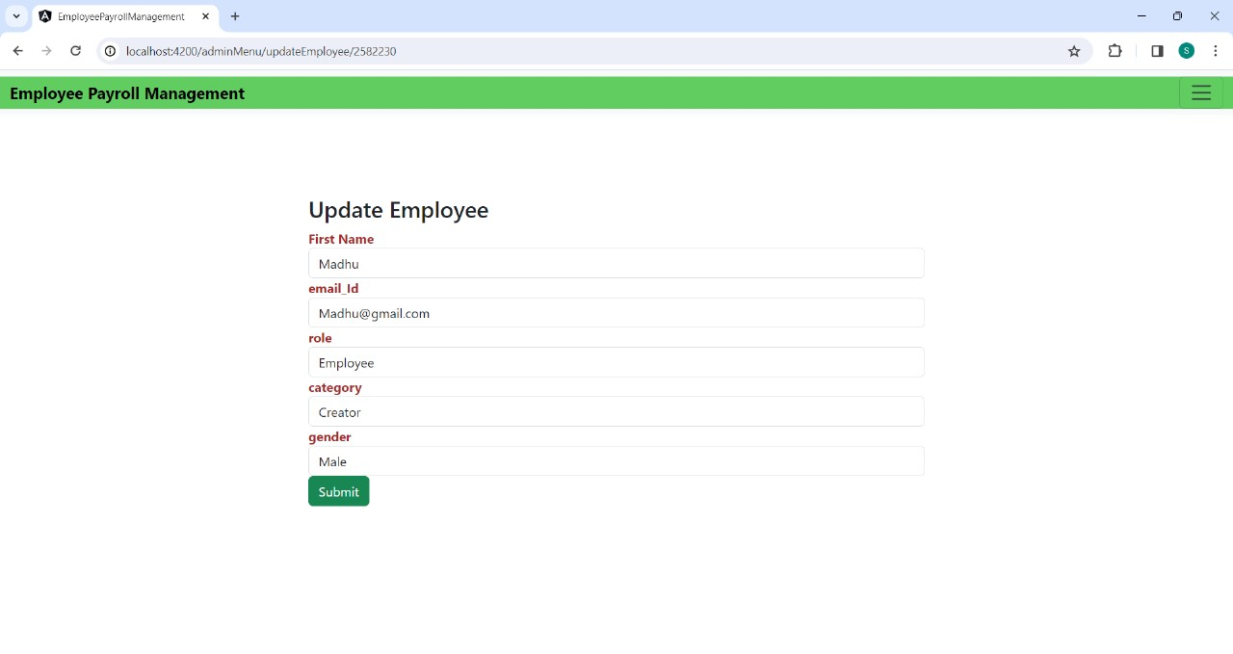
Update AND DELEte EMPLOYEES

Slide 25


Slide 26
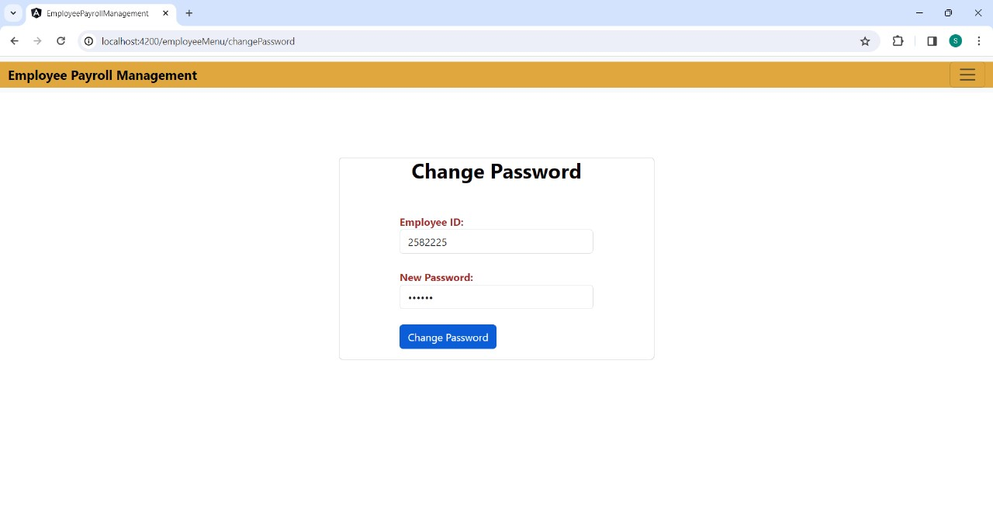
CHANGE PASSWORD

Slide 27
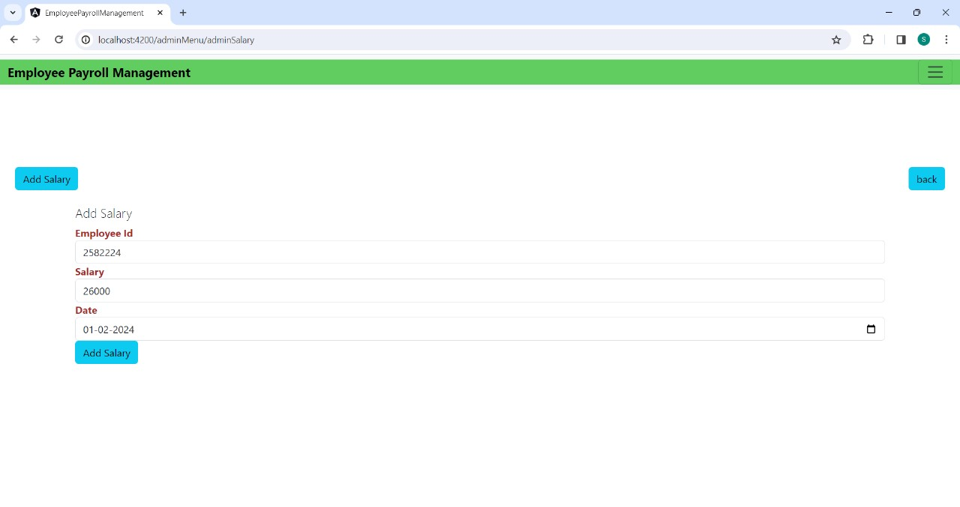
ADD SALARY OF EMPLOYEES

Slide 28
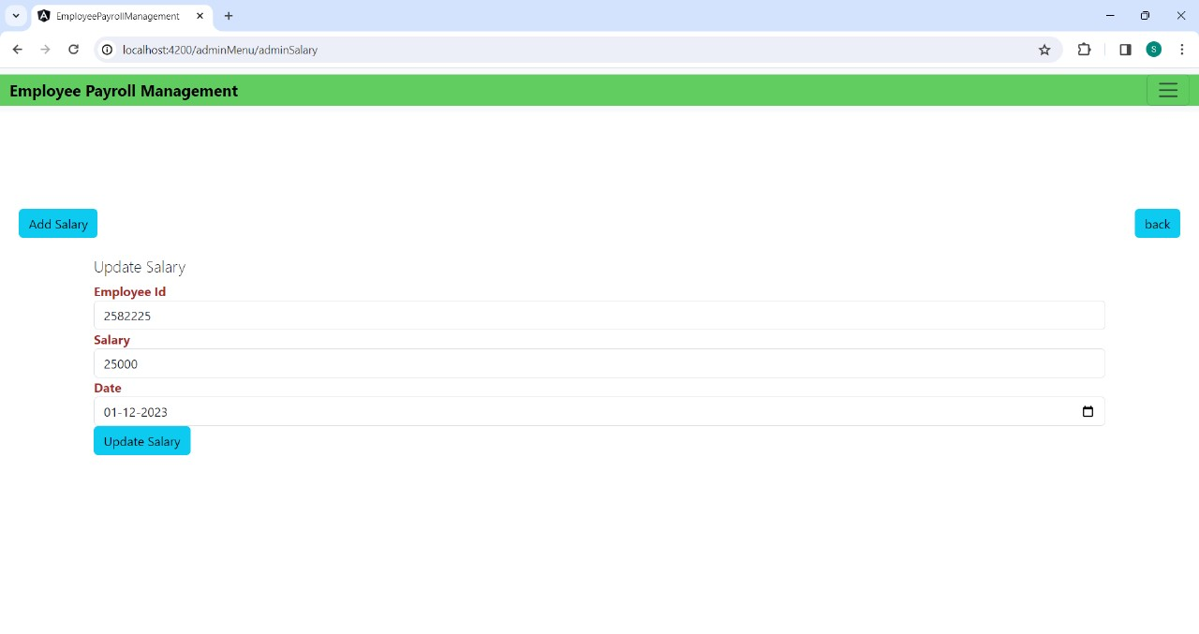
Edit Salary

Slide 29
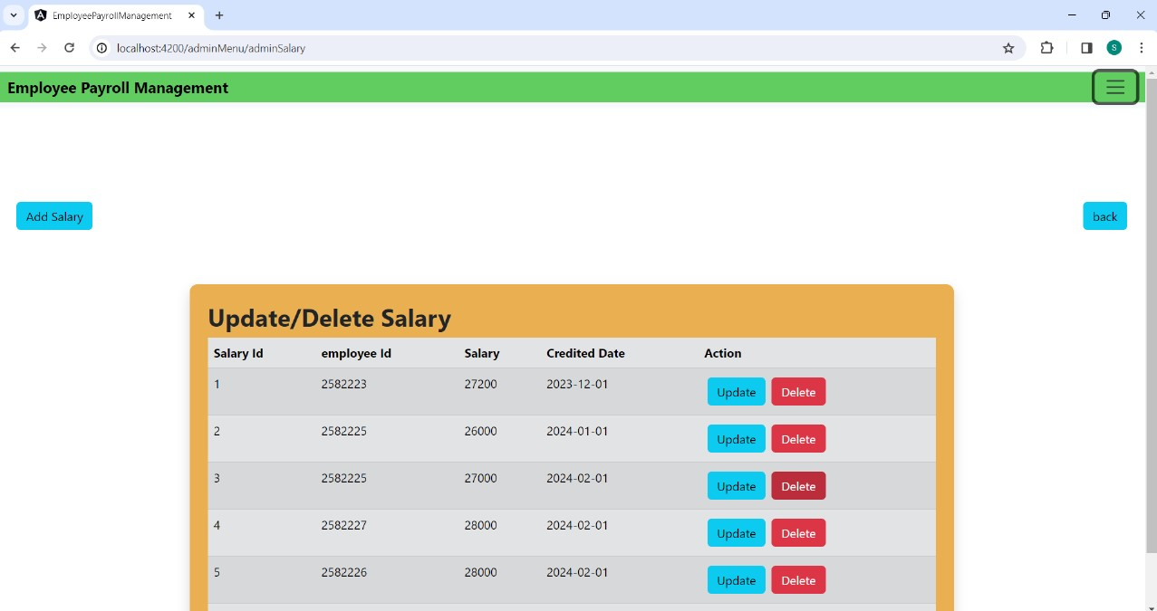
Delete Salary

Slide 30
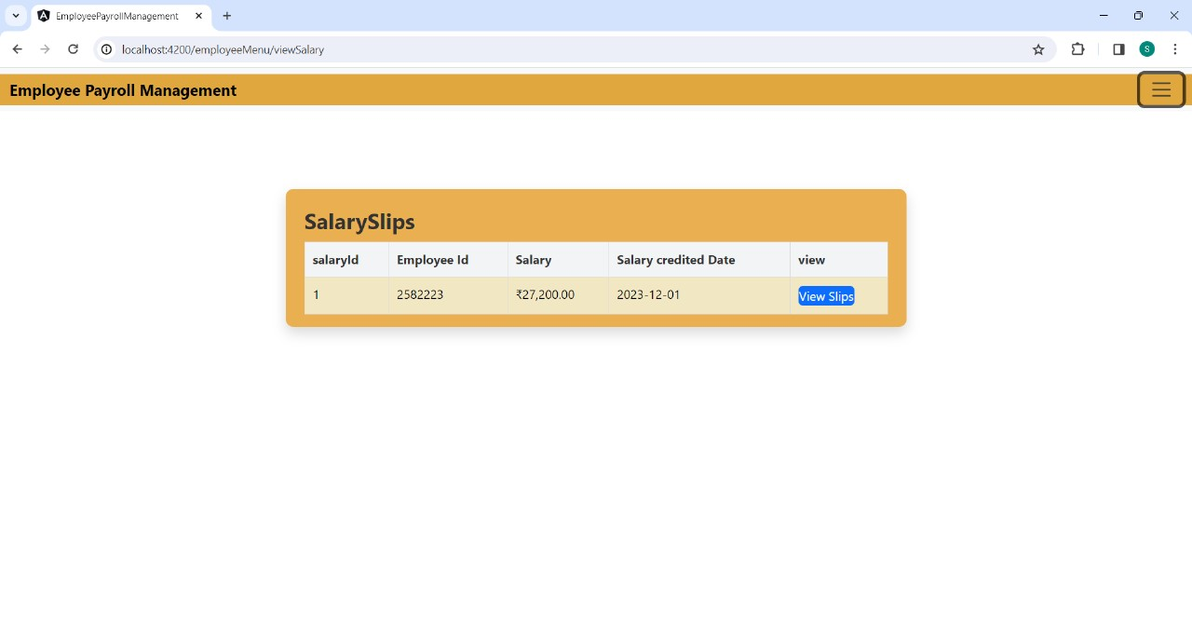
VIEW AND DOWNLOAD SALARY SLIPS OF EMPLOYEES

Slide 31
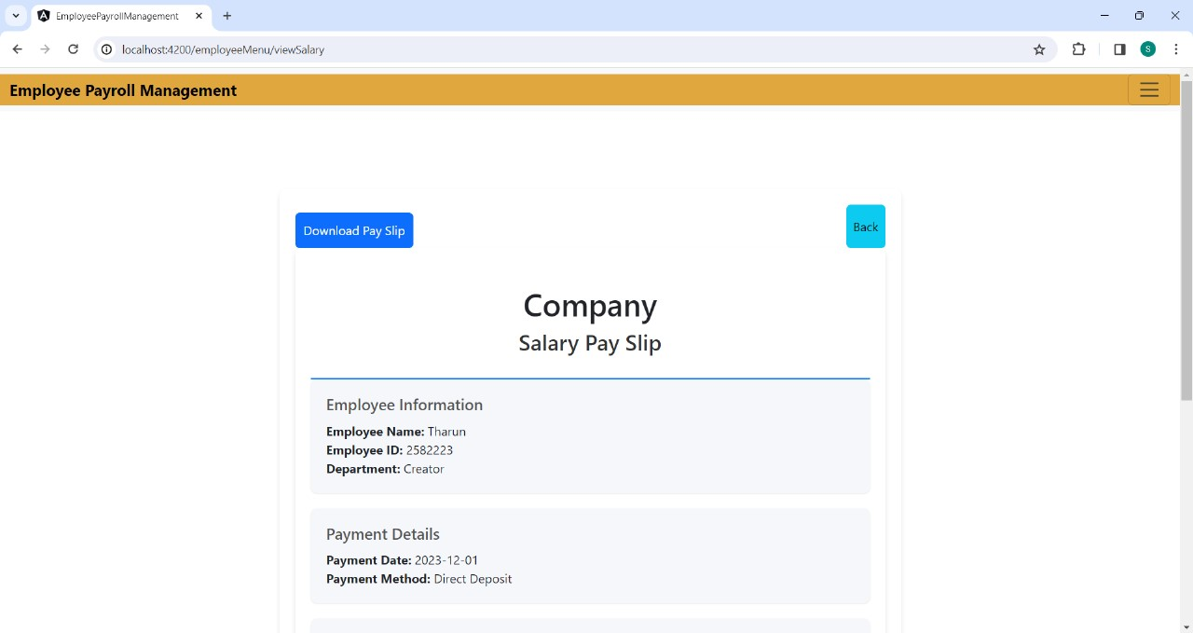
Download Pay Slip

Slide 32
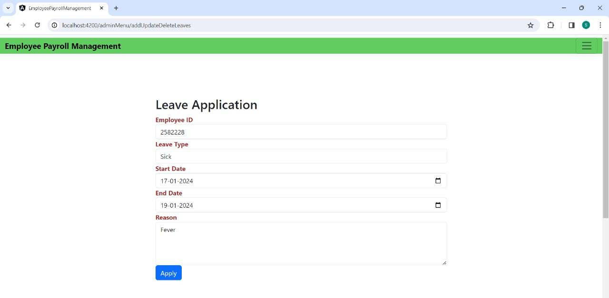
ADD LEAVES OF EMPLOYEES

Slide 33
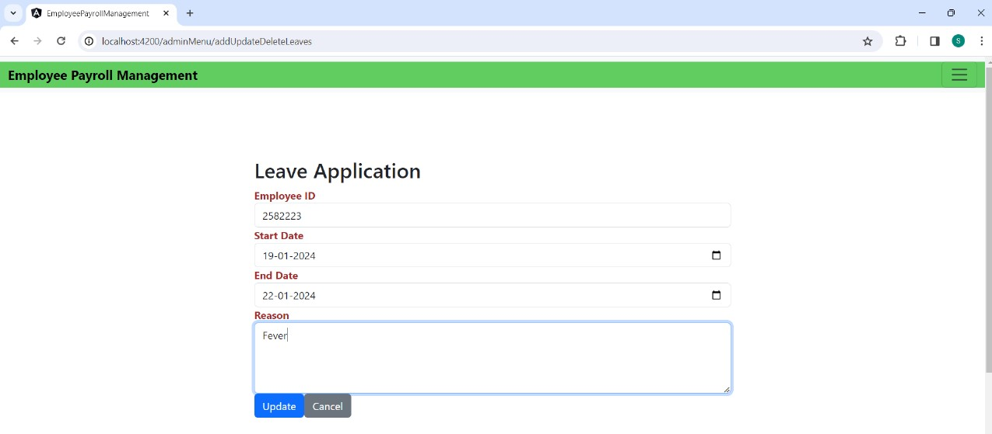
EDIT LEAVES OF EMPLOYEES

Slide 34
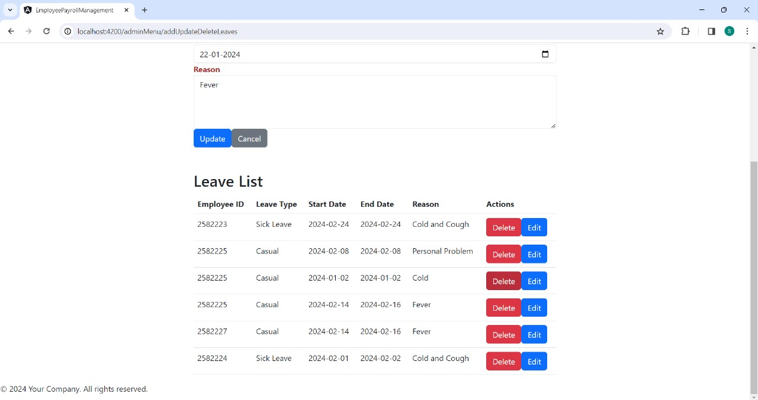
DELETE LEAVES OF EMPLOYEES

Slide 35
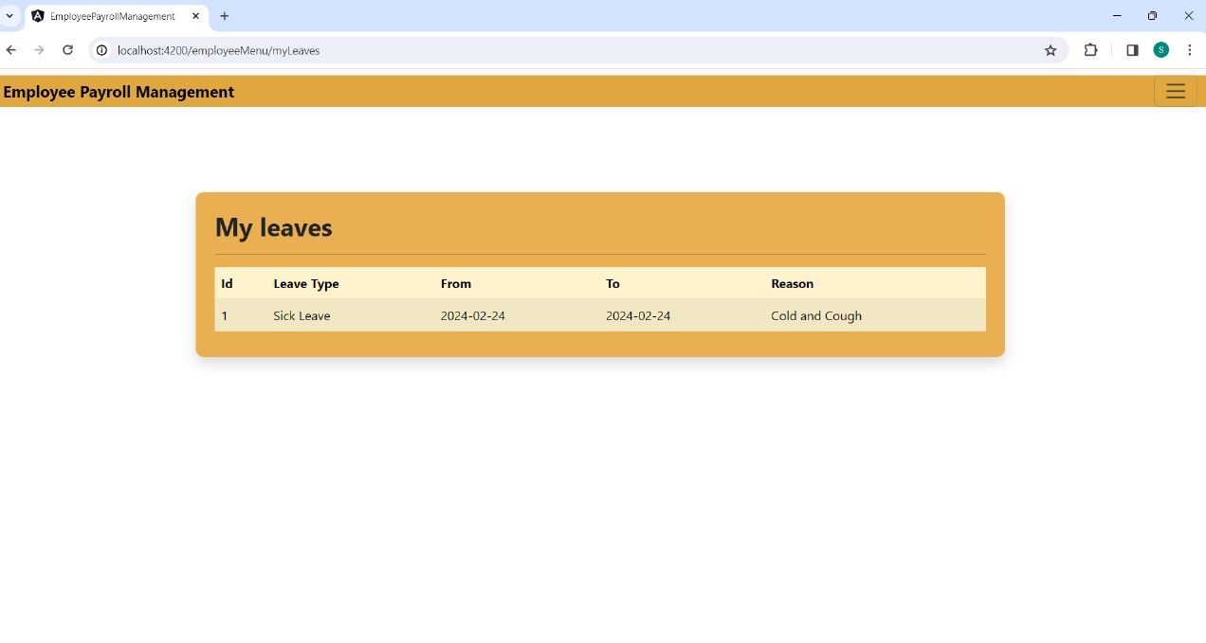
VIEW LEAVES OF EMPLOYEES

Slide 36
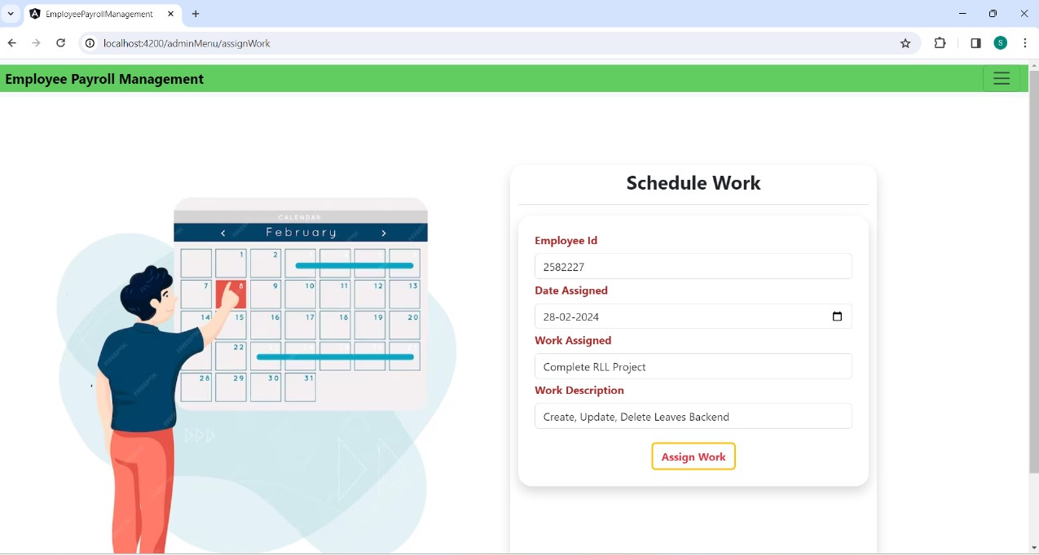
ADD WORK TO EMPLOYEE

Slide 37
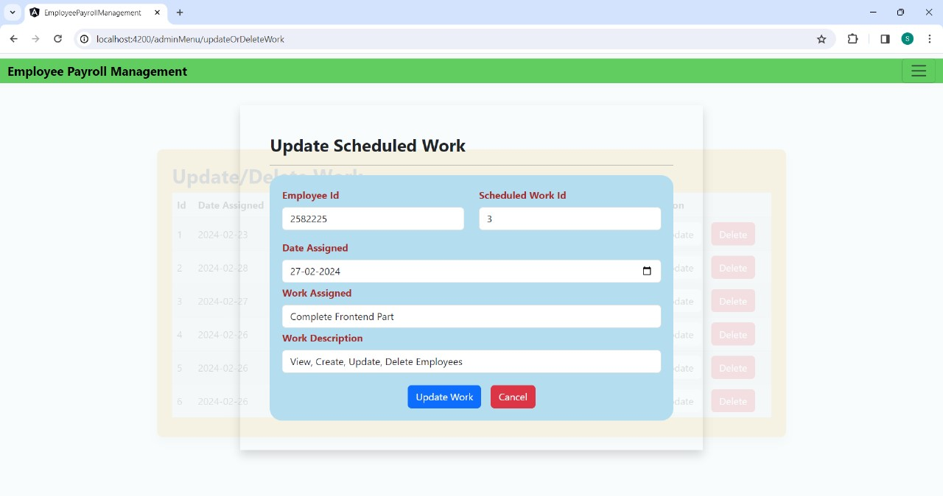
EDIT WORK FOR EMPLOYEE

Slide 38
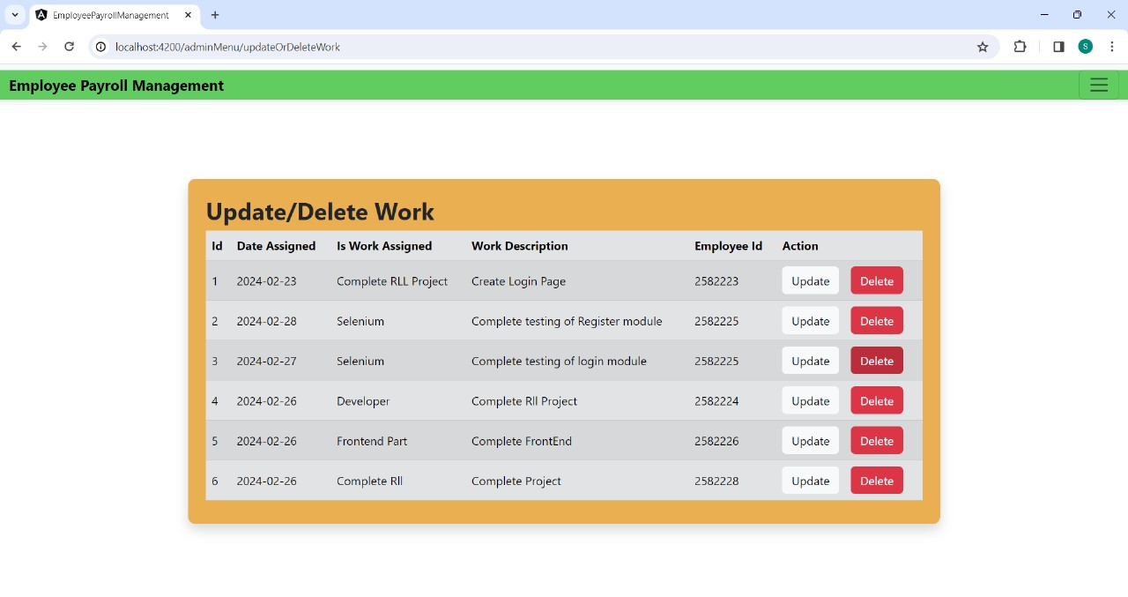
DELETE WORK OF EMPLOYEE

Slide 39
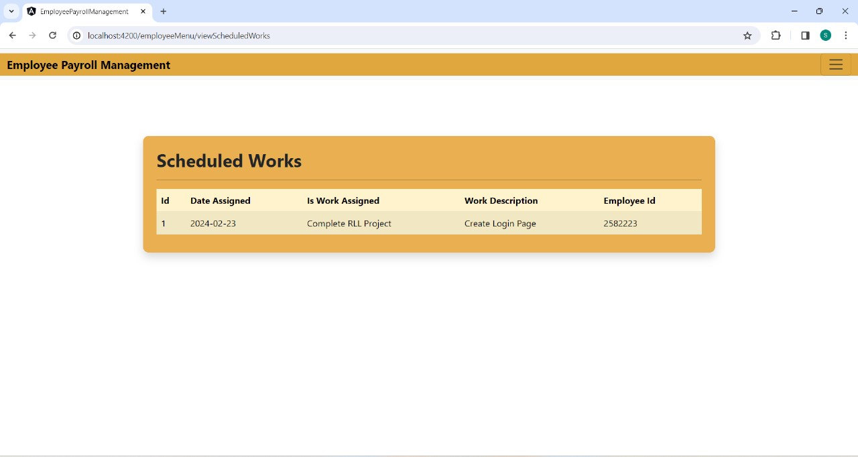
VIEW SCHEDULE WORK OF EMPLOYEE

Slide 40
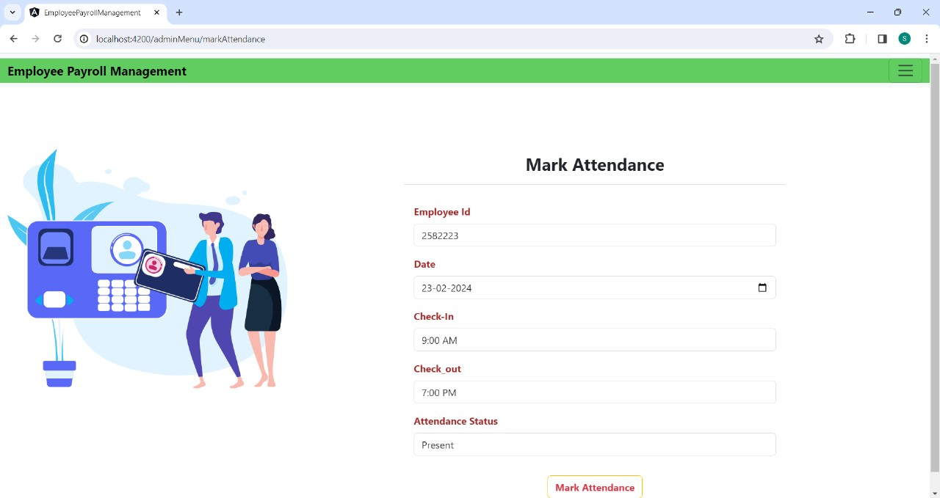
ADD ATTENDANCE

Slide 41
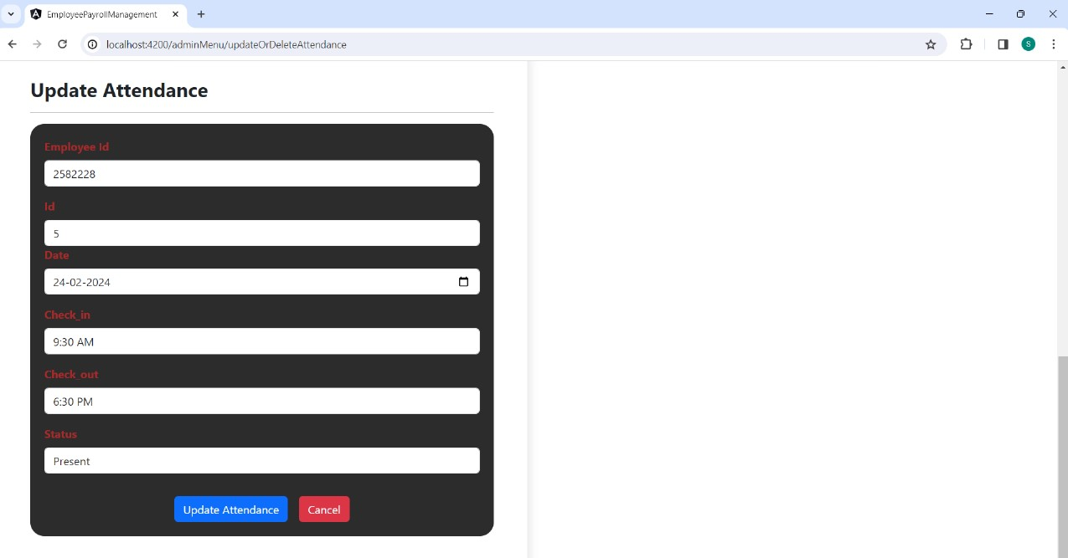
UPDATE ATTENDANCE

Slide 42
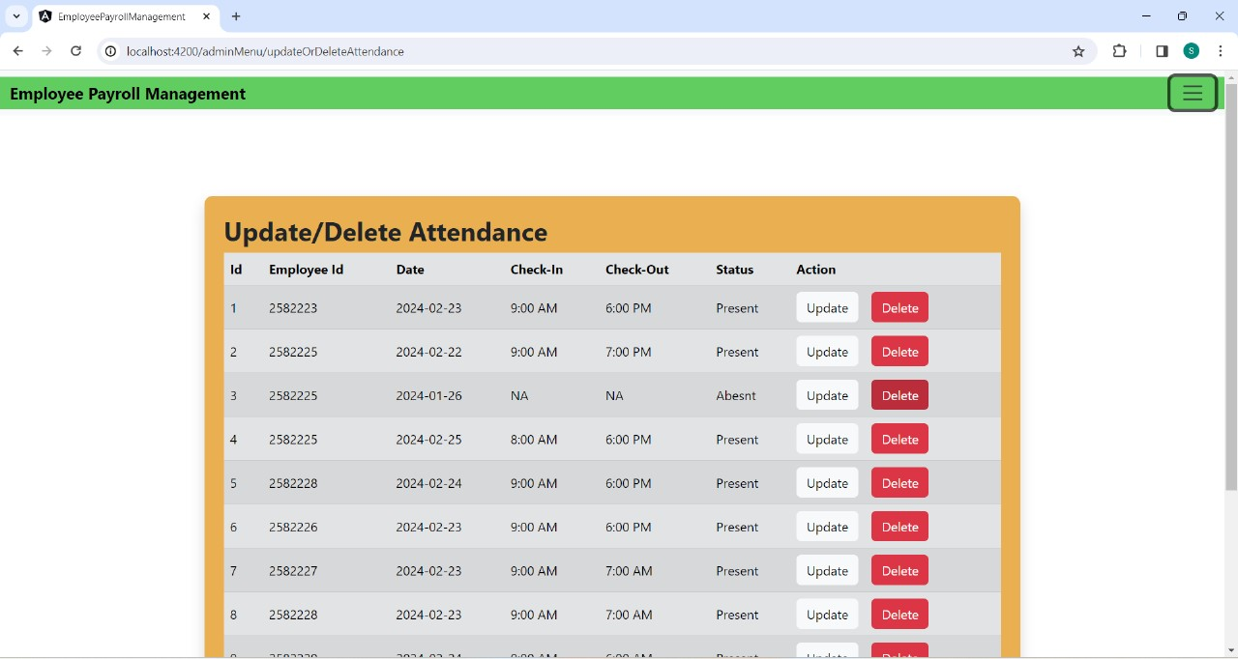
DELETE ATTENDANCE OF EMPLOYEES

Slide 43
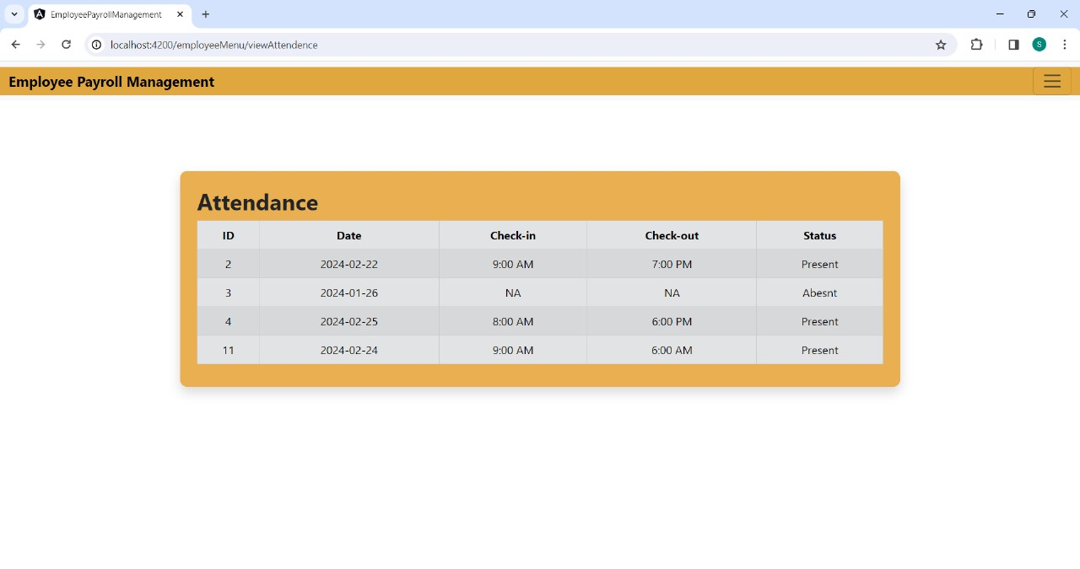
VIEW ATTENDANCE OF EMPLOYEES

Slide 44
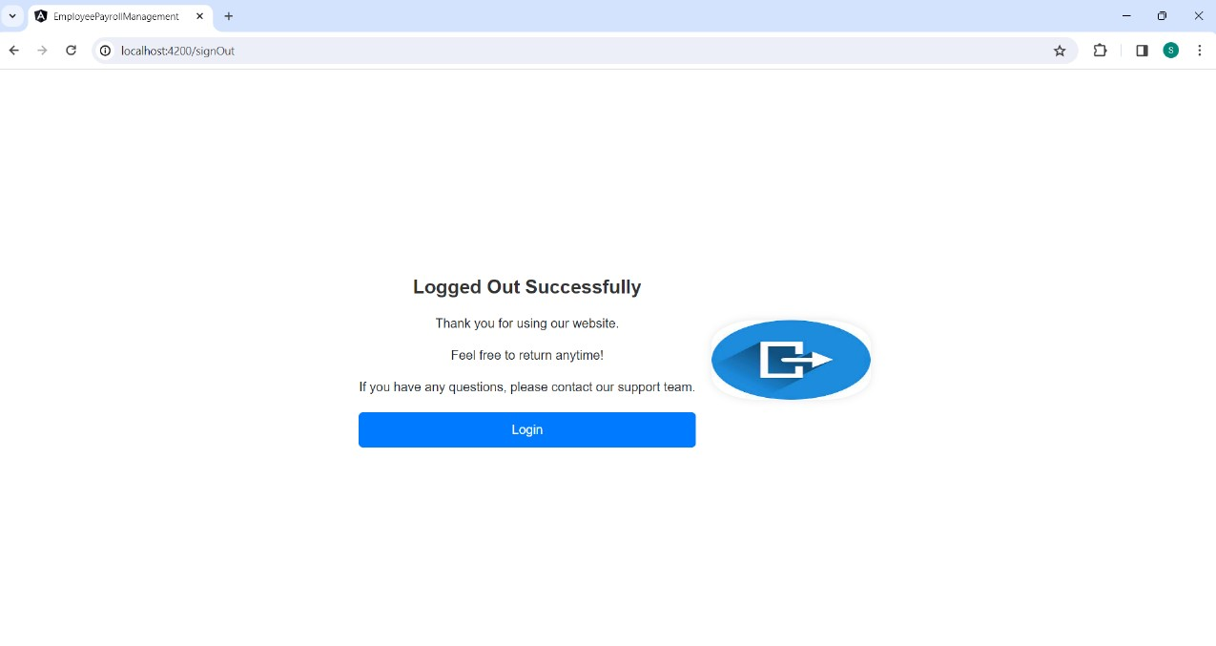
SIGN OUT

Slide 45
CONCLUSION
tailored for small organizations, our project caters to both admins and employees, particularly suitable for workplaces with a limited team. admins wield the authority to add, update, and remove employee information, manage new hires, and set salaries.
accessible records and monthly payments contribute to the project's goal of simplifying processes, saving time, cutting costs, and ensuring effective record management for smooth operations.

Slide 46


